Slide 1
Class 1: Overview

Slide 2
Administration and logistics
Materials
Notice of inability to participate fully
Laptops for note-taking
Slides posted on Brightspace
Office hours
Review sessions

Slide 3
Topics
Why study contract law?
What are we going to study?
What are you expected to learn?
Introductory cases

Slide 4
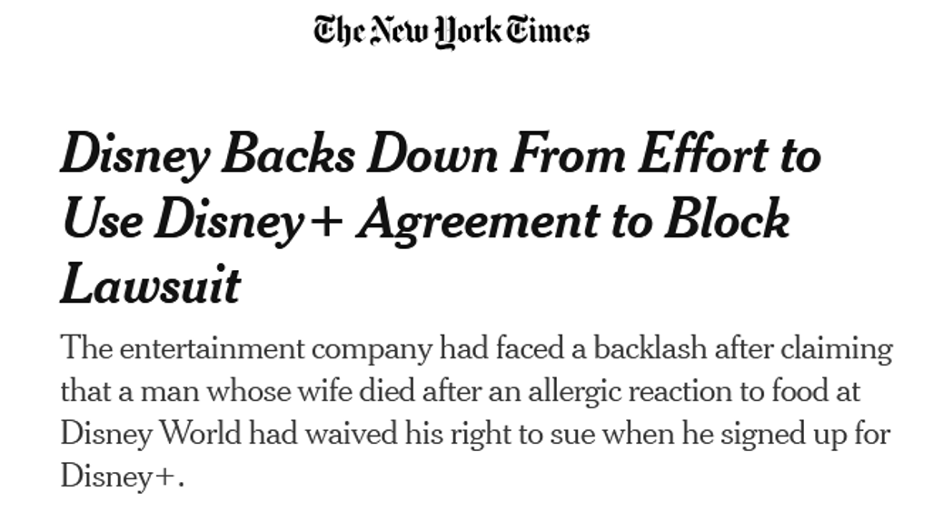
Why study contract law?
Contracts are everywhere
Contract law often trumps
Economic, moral and political significance
  Autonomy
  Efficiency
  Fairness
  Distributive justice
Professional benefits

Slide 5
Vonnegut on transactional lawyers
“In every big transaction... there is a magic moment during which a man has surrendered a treasure, and during which the man who is due to receive it has not yet done so. An alert lawyer will make that moment his own, possessing the treasure for a magic microsecond, taking a little of it, passing it on. If the man who is to receive the treasure is unused to wealth, has an inferiority complex and shapeless feelings of guilt, as most people do, the lawyer can often take as much as half the bundle, and still receive the recipient’s blubbering thanks.”

Slide 6
What are you expected to learn?
How to litigate contractual disputes.
How to draft contracts.

Slide 7
What are we going to study?
Is there an enforceable promise?
Has it been breached?
Has performance been excused?
How should the promise be enforced?

Slide 8
What are we going to study?
  Mutual assent/offer and acceptance
  Consideration
  Formal requirements
  Third party beneficiaries
  Duress
  Misrepresentation
  Unconscionability
  Public policy
  Parol evidence rule / use of extrinsic evidence
  Rules of construction
  Conditions
  Mistake
  Impracticability
  Frustration
  Specific relief
  Damages, including limitations
Formation
Validity
Interpretation
Excuses
Remedies
Related causes of action
Promissory estoppel
Restitution
Misrepresentation
Tortious interference
Negligence

Slide 9
Sources of US Contract Law
Treaties
  E.g., United Nations Convention on Contracts for the International Sale of Goods
Federal legislation
Federal common law
State legislation
  Uniform Commercial Code
    E.g. Article 2 (sale of goods)
  New York General Obligations Law
State common law
  Non-uniform
  Includes both common law and equity
  Synthesized in Restatement, Second, Contracts
Modes of Adjudication
Federal court*
State court*
Arbitration
*Note possibility of jury trial.

Slide 10
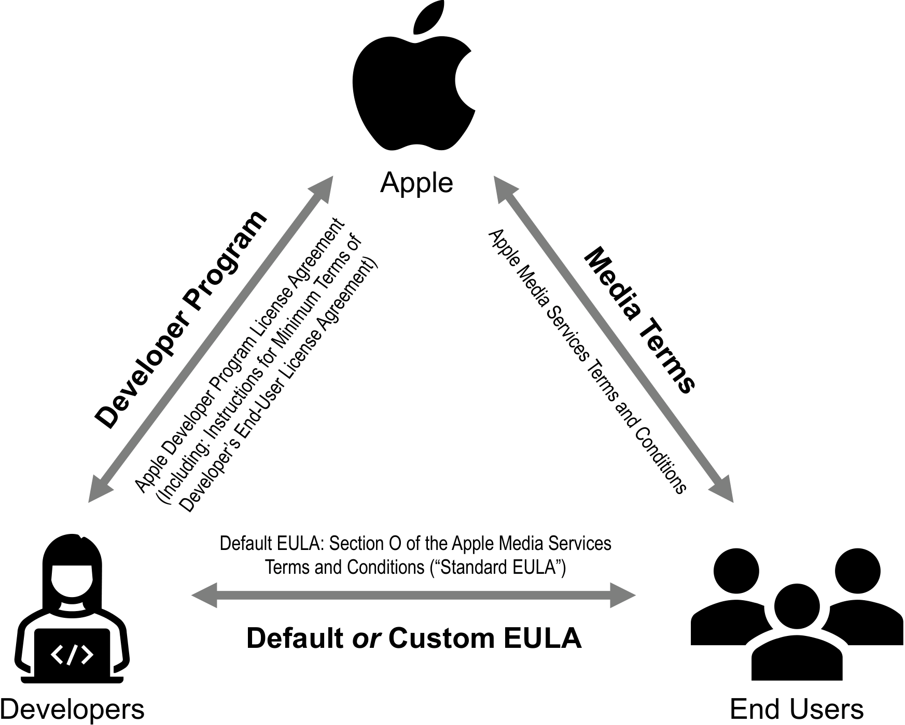
Apple App Store End User License Agreement
Apple App Store
Approx 2 million apps
“facilitated $1.3 trillion in billings and sales” (2024)
97.7% of apps use default EULA

Slide 11
Apple App Store End User License Agreement
What if the app developer fails to perform?
Do you have a claim in contract?
  Is there a contract?
  Has it been breached?
  Has performance been excused?
  How will it be enforced?
What if you fail to perform?
What procedural rules will govern any lawsuit?
Where will the adjudicator find the applicable legal rules?

Slide 12
Hawkins v. McGee (2)
What happened in this case?
Was there an enforceable promise? Why?
Was it breached?
How will the promise be enforced?

Slide 13
Hawkins v. McGee (2)
What happened in this case?
Was there an enforceable promise? Why?
Was it breached?
“Three or four days, not over four; then the boy can go home and it will be just a few days when he will go back to work with a good hand.”
“I will guarantee to make the hand a hundred per cent perfect hand or a hundred per cent good hand.”

Slide 14
Hawkins v. McGee (11)
What happened in this case?
Was there an enforceable promise? Why?
Was it breached?
How will the promise be enforced?
Operation pain, 100% perfect/good hand
Scarred hand
Operation pain, hairy hand

Slide 15
Bayliner Marine Corp. v. Crow (4)
What happened in this case?
Was there an enforceable promise? Why?

Slide 16
Bayliner Marine Corp. v. Crow (4)
What happened in this case?
Was there an enforceable promise? Why?
  What rules were applied?
What if the salesperson had said: “in my opinion, this boat will go 30 miles per hour, no trouble”?
What if there was no statement regarding speed but the boat had a maximum speed of two miles per hour?

Slide 17
UCC § 2-314
IMPLIED WARRANTY: MERCHANTABILITY
(1) Unless excluded or modified (Section 2-316), a warranty that the goods shall be merchantable is implied in a contract for their sale if the seller is a merchant with respect to goods of that kind. Under this section the serving for value of food or drink to be consumed either on the premises or elsewhere is a sale.
(2) Goods to be merchantable must be at least such as
(a) pass without objection in the trade under the contract description; and
(b) in the case of fungible goods, are of fair average quality within the description; and
(c) are fit for the ordinary purposes for which such goods are used; and
(d) run, within the variations permitted by the agreement, of even kind, quality and quantity within each unit and among all units involved; and
(e) are adequately contained, packaged, and labeled as the agreement may require; and
(f) conform to the promise or affirmations of fact made on the container or label if any.

Slide 18
Problems for next class
Applying the Interests, p. 18

